Slide 1


Slide 2
Introduction
Interior Designing has been a topic of interest across people of all age including young children to senior citizens.
With the advent of technology, it has become easier and quicker tp decide how one’s place would look like.
This is one of the key areas where AR aided object rendering can be used in order to generate a collaborative view of how actually virtual objects would look in real life.

Slide 3
Problem Statement
With the Covid Pandemic forced social distancing, all the businesses were forced to innovate. The interior designing industry wasn’t different.
Customers now prefer to get their homes designed without coming into physical contact. This led to the boom of AR based apps which would help the consumers to decide how the objects would in real-life when kept at the desired place.

Slide 4
Motivation
Lack of AR-based apps which can help the people to decide what to place and where to place without professional help.
This would help one to better design one’s personal space.
Challenges
Simulation Errors: The main aim was to have as low as possible discrepancies when it comes to simulating virtual objects. This was the major task as many objects may not be rendered completely, spoiling the users’ experience.
Physics Used: Even though the rendering may be accurate, the major task was to ensure that the rendered objects are complied with the real-world.

Slide 5
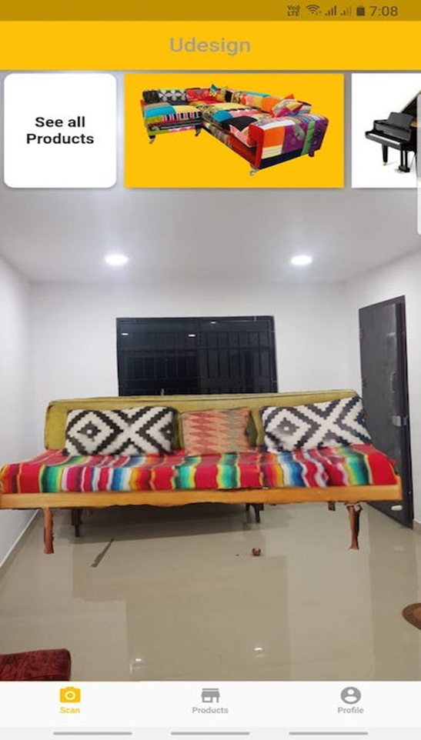
Our Solution: DecorIn
We created an AR-based app which would help the users in placing objects in real life 3-D space.
This app can help in interior designing using marker-based tracking
We have added a list of several pre-loaded products so as to facilitate the user to decide onto home furnishing

Slide 6
Approach towards the project
Initially discussed onto how the app would look like. Made blueprints for the app. Did research onto similar kind of apps present into the market. Also, started to develop the UI of the app.
Implemented and interconnected each feature class. Several bugs detected were removed. Rendering related issues were regularly removed with each release.
Enhanced the user experience by adding more products and a recommendation system. A login system was added so as to personalize the app.

Slide 7
Key Features
Use of Marker-based AR technology
List of Pre-loaded or rather hard-coded products.
Recommendation System: allows oneself to recommend some missing products
Authentication feature: helps to keep unauthorized access away from the app

Slide 8
Results
We are successfully able to render AR-based images for the hard-coded products with the help of Marker-based AR tech.
Majority of the glitches have been removed from the app and we are constantly working on to enhance the UI of the app.
Screenshot of some of the results is displayed on the next slide:

Slide 9
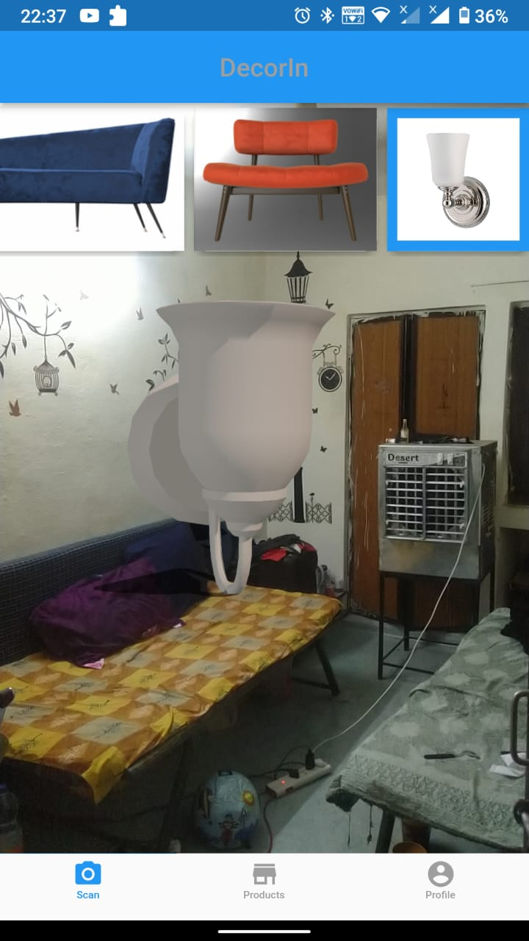
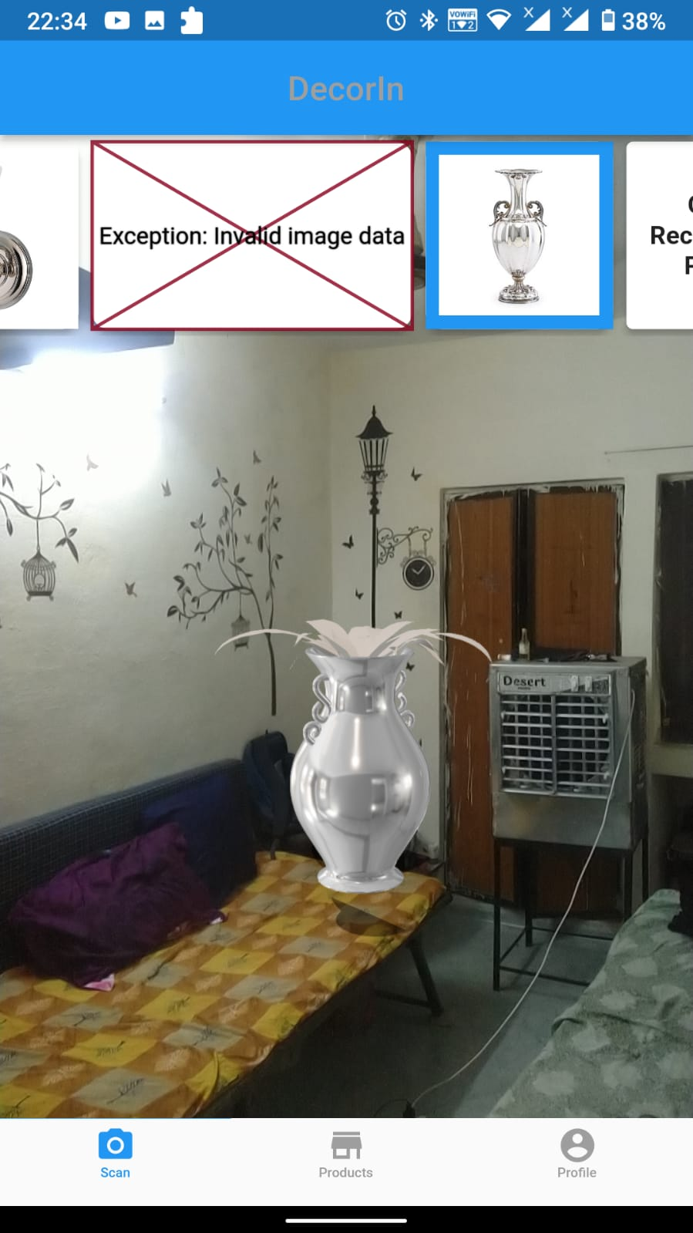
Wall Lamp Prediction
Table Pot Prediction

Slide 10
Team Members: Group-8
Pragyan Jaiminy
Pushpak Prateek
Manish Saini
Kumar Pratyay
L Ashwin

